Slide 1
CGB1221-DATABASE MANAGEMENT SYSTEM
Department of Artificial Intelligence and Data Science
Academic Year: 2024 – 2025
Register Number : 2303811724322080
Name : PADMAPRIYA S
Year : II
Semester : IV
Section : B
Date : 04.06.2025

Slide 2
Title of the Project
COLLEGE EVENT
MANAGEMENT SYSTEM

Slide 3
Problem Identification
Managing college events manually can be time-consuming, inefficient, and error-prone. Traditional event management relies on paper-based registrations, manual scheduling, and disorganized communication, leading to issues such as mismanagement of resources, lack of coordination, and difficulties in tracking participation.

Slide 4
Objective
The primary objective of the College Event Management System is to streamline the process of event planning, registration, coordination, and management for both students and faculty. The system aims to:
Automate event registration to reduce manual errors and improve accessibility.
Enhance event coordination through real-time updates and notifications.
Ensure efficient resource allocation by tracking venue bookings and event logistics.
Provide event analytics and reports for better decision-making.
Improve user experience with a simple and interactive web-based platform

Slide 5
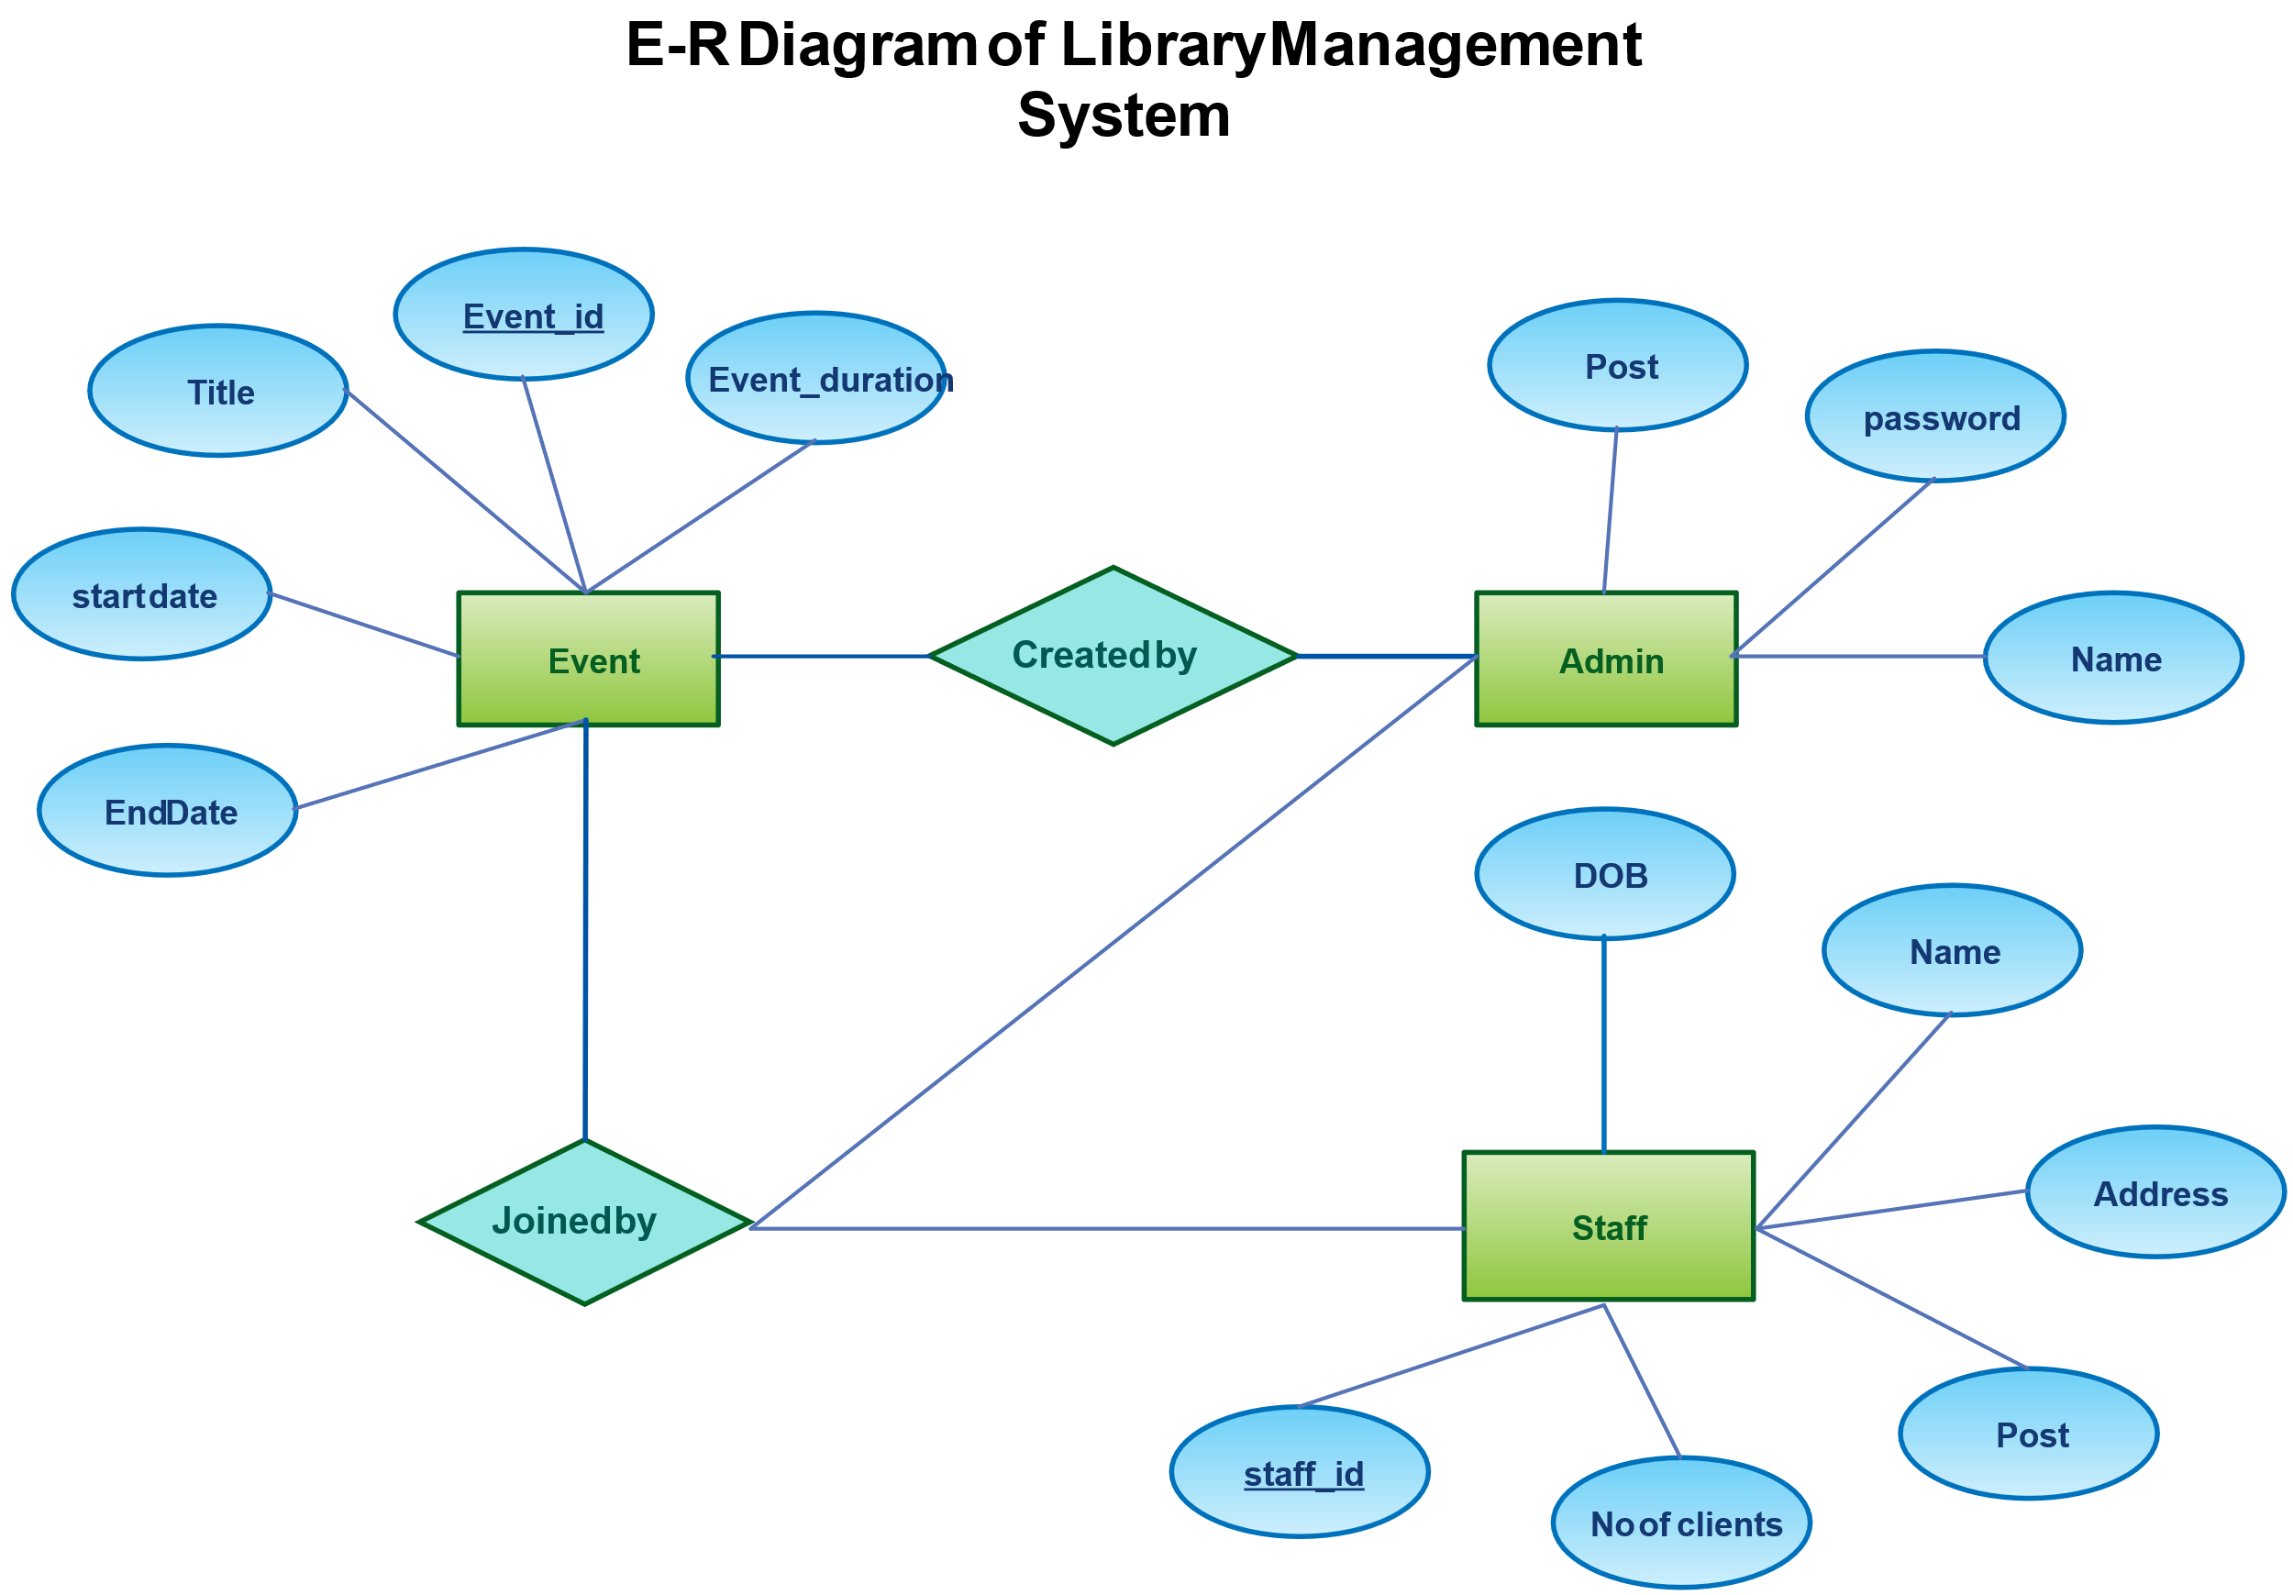
Proposed Architecture

Slide 6
List of Modules
User Management Module
Event Management Module
Registration Module
Database Module
Notification & Report Module

Slide 7
Module Description
1. User Management Module
This module handles the registration, login, authentication, and role-based access control for all users of the system. Users can register as students, faculty, or administrators. The module ensures secure access using password encryption and validates user roles to allow appropriate privileges (e.g., only organizers and admins can create or manage events).

Slide 8
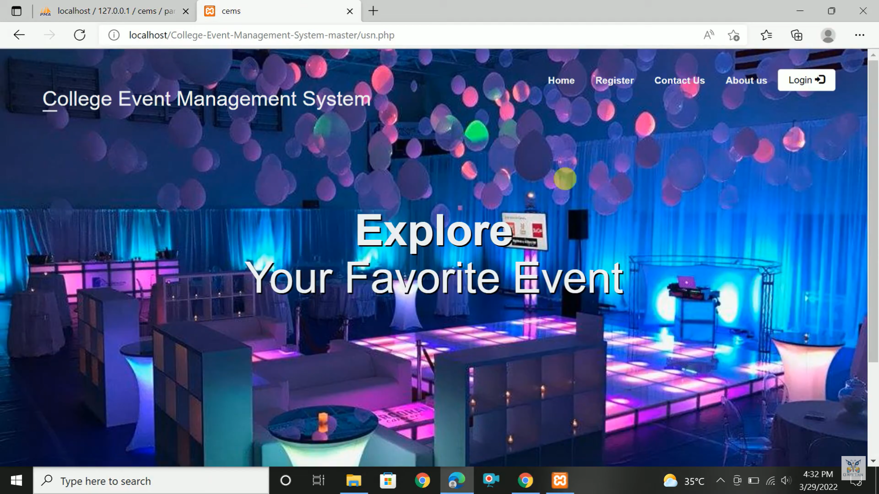
Results

Slide 9
Module Description (Cont..)
2. Event Management Module
This module allows authorized users (organizers and admins) to create, update, view, and delete event details such as event name, date, time, venue, and description. It also manages scheduling and conflict detection to prevent overlapping events. Event listings are made available for students and faculty to view and register.

Slide 10
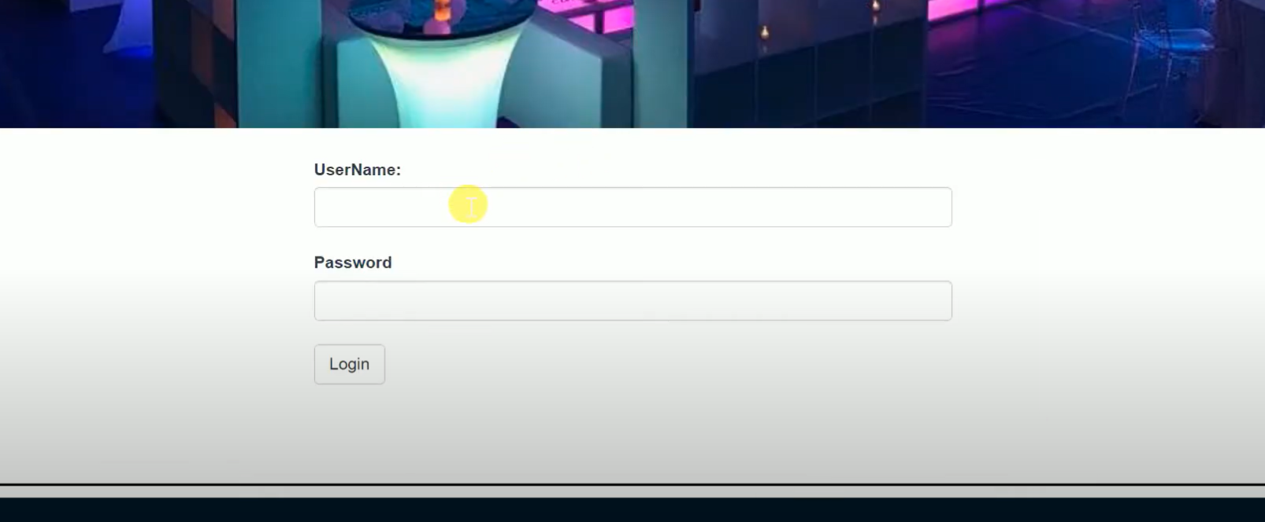
Results

Slide 11
Module Description (Cont..)
3. Registration Module
This module facilitates user registration for events. Students and faculty can browse available events and register with a single click. It maintains a record of all registrations, which can be tracked by event organizers. It also prevents duplicate registrations and manages registration limits if set by the organizer.

Slide 12
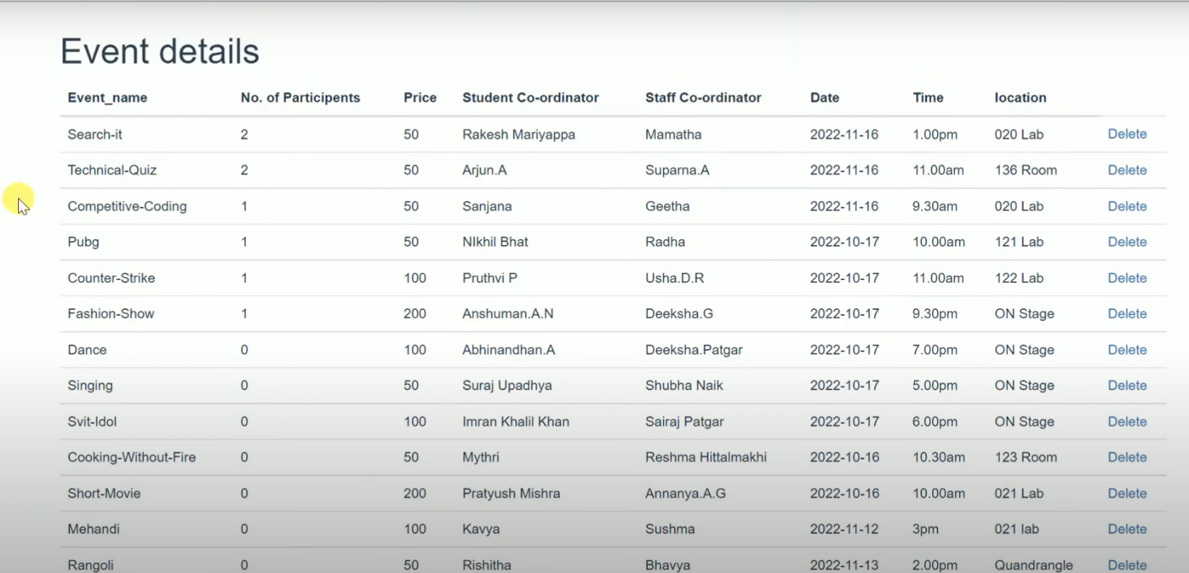
Results

Slide 13
Module Description (Cont..)
4. Database Module (MySQL)
MySQL serves as the data storage layer. It stores the registration data submitted by students.
MySQL Server:
A relational database that holds structured data.
Tables:
registrations: A table that stores each registration entry with fields like name, email, and event.
MySQL Node Package:
Allows the Node.js server to connect to MySQL and run queries (like INSERT INTO registrations VALUES (...)).

Slide 14
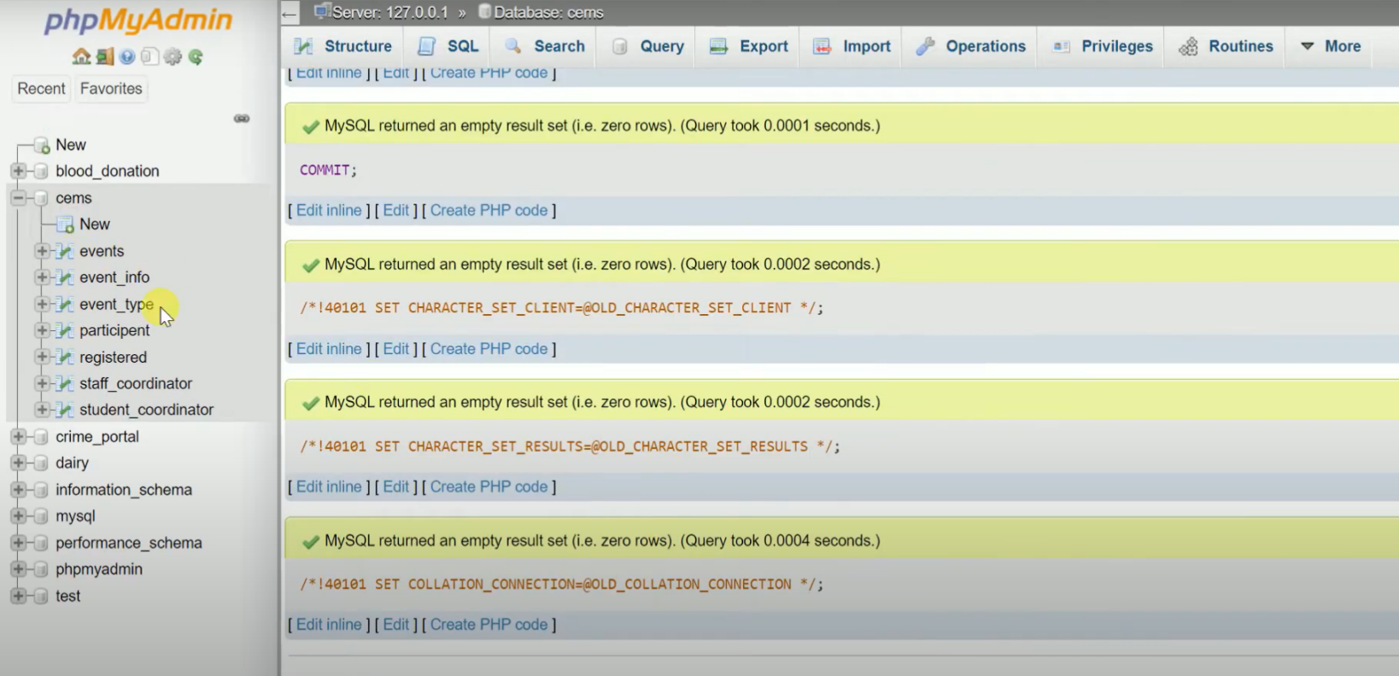
Results

Slide 15
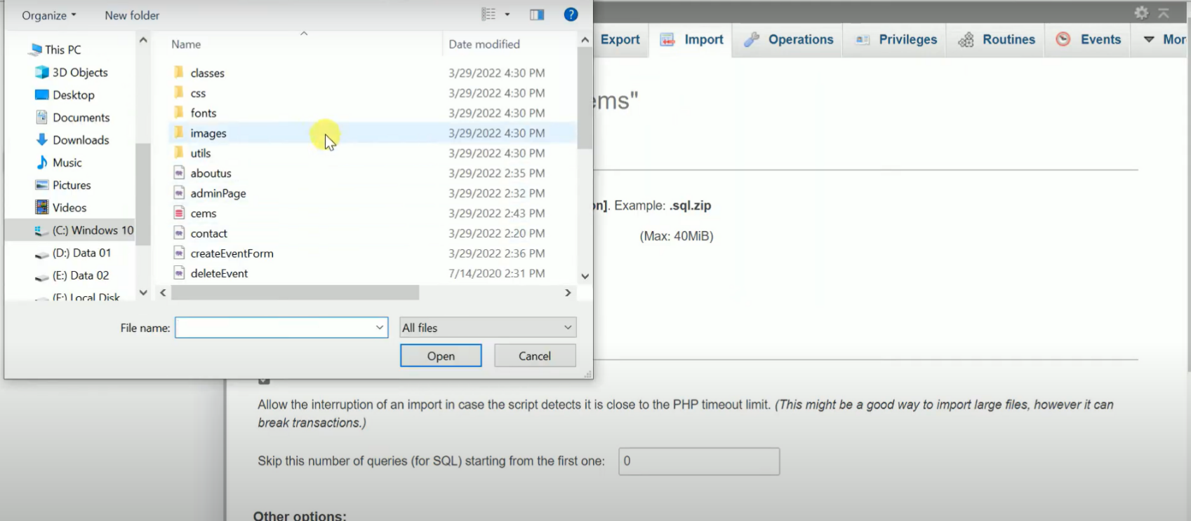
Results

Slide 16
Module Description (Cont..)
5. Notification & Report Module
This module is responsible for sending real-time notifications (e.g., event updates, registration confirmations, reminders) through email or dashboard alerts. It also generates analytical reports for administrators and organizers, including participant counts, feedback summaries, and resource utilization, aiding in event review and future planning.

Slide 17
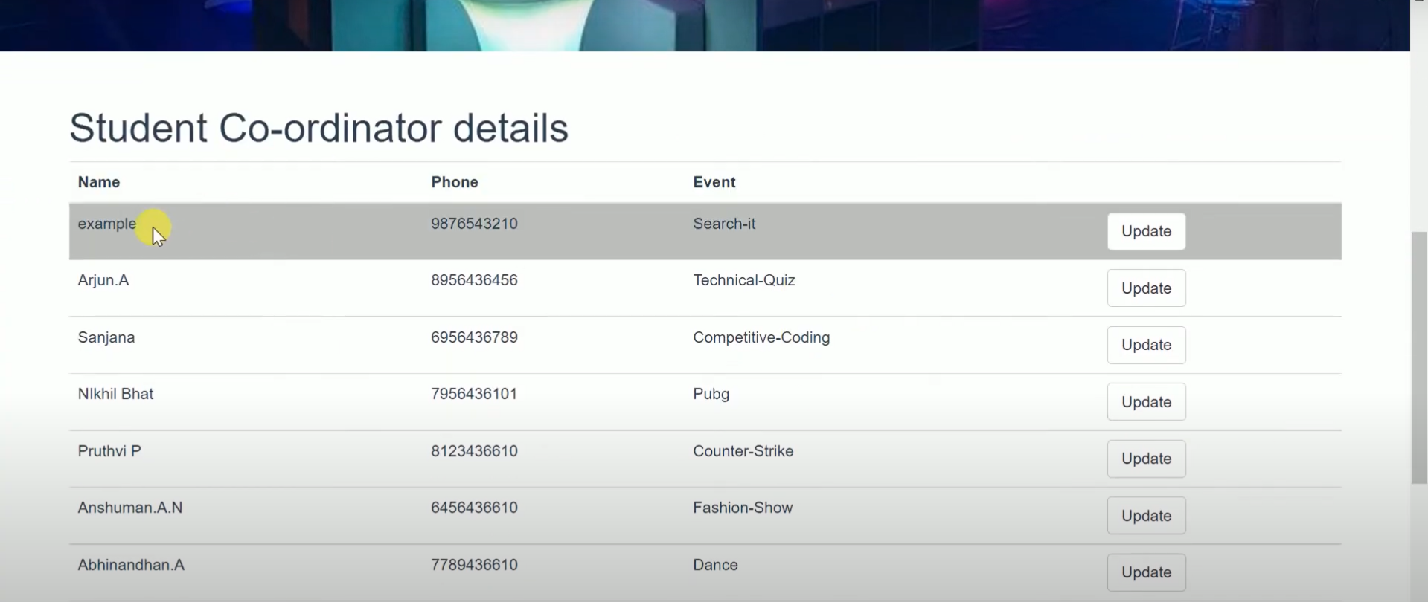
Results

Slide 18
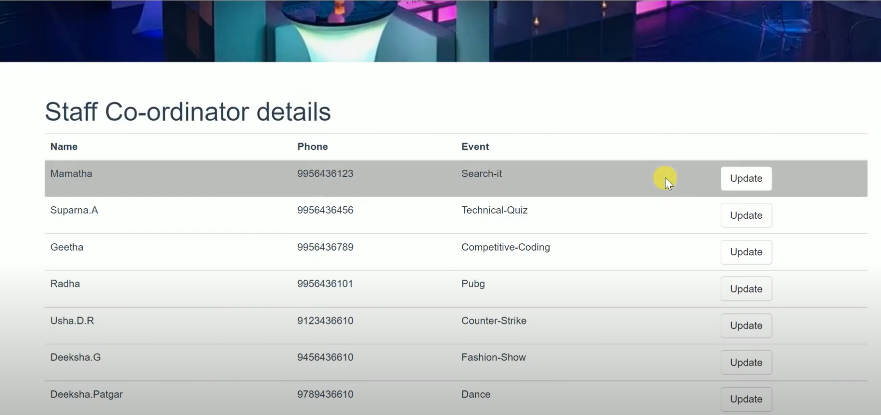
Results

Slide 19
Conclusion
The College Event Management System is a comprehensive and efficient platform designed to simplify the organization and coordination of events within a college environment. By automating various aspects such as event creation, registration, resource allocation, and communication, the system significantly reduces manual workload and ensures smooth execution of campus activities. It enhances collaboration among students, faculty, and administrators through real-time updates and centralized access to information. The implementation of role-based access, structured database management, and user-friendly interfaces further contribute to the system's effectiveness, reliability, and scalability. Overall, the system improves the transparency, accessibility, and efficiency of managing college events.

Slide 20
FUTURE SCOPE
The College Event Management System can be enhanced with several advanced features to increase its functionality and user engagement. Mobile application integration can provide students and staff with easier access and real-time notifications on the go. Integration with college portals and social media platforms can broaden event visibility and participation. Additional features such as feedback collection, event rating systems, attendance tracking using QR codes or biometric systems, and AI-based resource prediction can make the system smarter and more responsive. Moreover, incorporating cloud storage and hosting can improve scalability and accessibility, especially for larger institutions. These enhancements will make the system a more powerful tool for effective event planning and management in academic institutions.

Slide 21
Thank You
Any queries???

